Slide 1
Research: Concept, process
Dr. Vinit Kumar

Slide 2
Concept of Research…
Systematic investigation to establish facts or principles or to collect information on a subject
To carry out investigations into (a subject, problem, etc.)
In the broadest sense of the word, the definition of research includes any gathering of data, information and facts for the advancement of knowledge.
Reading factual book of any sort is kind of research.
Surfing the internet or watching the news is also type of research.
Research is undertaken within most professions.
Science does not use this word in same way, preferring to restrict it to certain narrowly defined areas.
More than a set of skills, it is a way of thinking: examining critically the various aspects of your professional work.
It is a habit of questioning what you do, and a systematic examination of the observed information to find answers with a view to bring appropriate changes for a more effective professional service.

Slide 3
Concept of Research…
Word research is derived from Middle French "recherche", which means "to go about seeking"
The earliest recorded use of the term was in 1577.
Definition of research by OECD, "Any creative systematic activity undertaken in order to increase the stock of knowledge, including knowledge of man, culture and society, and the use of this knowledge to devise new applications“
Research must be systematic and follow series of steps & rigid standard protocol

Slide 4
Definitions of Research
“Research is an honest, exhaustive, intelligent searching for facts and their meaning or implications with reference to a problem.” (Cook, P. M. 1929)
“…research per se constitutes a method for discovery of truth which is really a method of critical thinking.” (Clifford Woody 1927)
“Research represents a critical exhaustive investigation to discover new facts, to interpret them in the light of known ideas, theories and laws, to revive the current laws and theories in the light of the newly discovered facts to apply the conclusion to practical purpose.” (Prof S R Ranganathan)
“Research is best conceived as the process of arriving at dependable solutions to problems through the planned and systematic collection, analysis and interpretation of data.” (George Mouly, 1978)
“Research is as the conduct of special, planned and structured investigation and as a systematic quest for knowledge.” (Charles Busha & Stephen Harter)
The Merriam-Webster Online Dictionary defines research as "studious inquiry or examination; especially : investigation or experimentation aimed at the discovery and interpretation of facts, revision of accepted theories or laws in the light of new facts, or practical application of such new or revised theories or laws"

Slide 5
Research Process
John W. Creswell, states that "[r]esearch is a process of steps used to collect and analyze information to increase our understanding of a topic or issue“
Consists of three steps:
pose a question
collect data to answer the question
present an answer to the question
Research is a process of collecting, analyzing and interpreting information to answer questions.
But to qualify as research, the process must have certain characteristics: it must, as far as possible, be controlled, rigorous, systematic, valid and verifiable, empirical and critical.

Slide 6
Characteristics of research
For a process to be called research, it is essential that it has the following characteristics.
Controlled - in real life there are many factors that affect an outcome. The concept of control implies that, in exploring causality in relation to two variables (factors), you set up your study in a way that minimizes the effects of other factors affecting the relationship. This can be achieved to a large extent in the physical sciences but in case of social science we attempt to quantify their impact.
Rigorous – It must be ensured that the procedures followed to find answers to questions are relevant, appropriate and justified. The degree of rigor varies markedly between the physical and social sciences and within the social sciences.
Systematic - this implies that the procedure adopted to undertake an investigation follow a certain logical sequence. The different steps cannot be taken in a haphazard way. Some procedures must follow others.
Valid and verifiable - this concept implies that whatever you conclude on the basis of your findings is correct and can be verified by you and others.
Empirical - this means that any conclusion drawn are based upon hard evidence gathered from information collected from real life experiences or observations.
Critical – critical scrutiny of the procedures used and the methods employed is crucial to a research enquiry. The process of investigation must be foolproof and free from drawbacks. The process adopted and the procedures used must be able to withstand critical scrutiny.

Slide 7
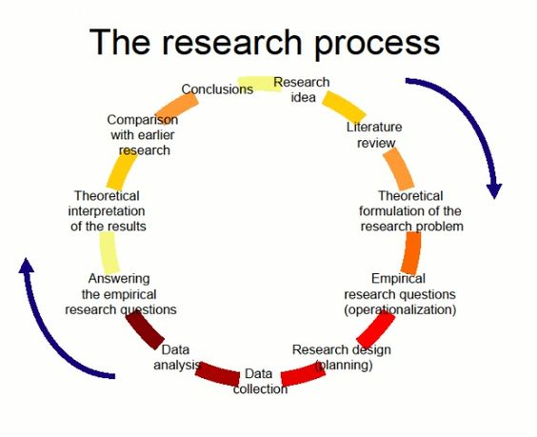
Source: https://i.pinimg.com/564x/12/d8/fb/12d8fb0cc8f3ef9530f9dcf19e6afce2.jpg

Slide 8
Steps in conducting research
Research is often conducted using hourglass model structure of research
Hourglass model starts with broad spectrum for research, focusing in on required information through method of project (like the neck of the hourglass), then expands research in form of discussion & results.
Major steps in conducting research are:
Identification of research problem
Literature review
Specifying purpose of research
Determining specific research questions
Specification of conceptual framework, usually set of hypotheses
Choice of methodology (for data collection)
Data collection
Verifying data
Analyzing & interpreting data
Reporting & evaluating research
Communicating research findings & recommendations

Slide 9
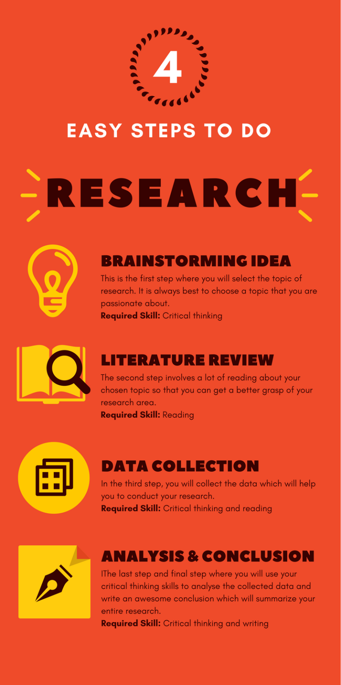

Slide 10
Step1 : Identification of research problem
It is the first and most crucial step in the research process –
Main function is to decide what you want to find out about.
The way you formulate a problem determines almost every step that follows.
Sources of research problems
Research in social sciences revolves around four Ps:
People/system - a group of individuals
Problems - examine the existence of certain issues or problems relating to their lives; to ascertain attitude of a group of people towards an issue
Programs - to evaluate the effectiveness of an intervention
Phenomena - to establish the existence of a regularity.
In practice most research studies are based upon at least a combination of two Ps.

Slide 11
Aspects of social science research study
Every research study has two aspects:
1. Study population-
People: individuals, organizations, groups, communities or system
( they provide you with the information or you collect information about them)
2. Subject area-
Problems: issues, situations, associations, needs, profiles
Program : content, structure, outcomes, attributes, satisfactions, consumers, Service providers, etc.
Phenomenon: cause-and-effect relationships, the study of a phenomenon itself
(Information that you need to collect to find answers to your research questions)
You can examine the professional field of your choice in the context of the four Ps in order to identify anything that looks interesting.

Slide 12
Considerations in selecting a research problem:
These help to ensure that your study will remain manageable and that you will remain motivated.
Interest: a research endeavour is usually time consuming, and involves hard work and possibly unforeseen problems. One should select topic of great interest to sustain the required motivation.
Magnitude: It is extremely important to select a topic that you can manage within the time and resources at your disposal. Narrow the topic down to something manageable, specific and clear.
Measurement of concepts: Make sure that you are clear about the indicators and measurement of concepts (if used) in your study.
Level of expertise: Make sure that you have adequate level of expertise for the task you are proposing since you need to do the work yourself.
Relevance: Ensure that your study adds to the existing body of knowledge, bridges current gaps and is useful in policy formulation. This will help you to sustain interest in the study.
Availability of data: Before finalizing the topic, make sure that data are available.
Ethical issues: How ethical issues can affect the study population and how ethical problems can be overcome should be thoroughly examined at the problem formulating stage.

Slide 13
Steps in formulation of a research problem
Step 1 Identify a broad field or subject area of interest to you.
Step 2 Dissect the broad area into sub areas.
Step 3 Select what is of most interest to you.
Step 4 Raise research questions.
Step 5 Formulate objectives.
Step 6 Assess your objectives.
Step 7 Double check.
Notes:
Working through these steps presupposes a reasonable level of knowledge in the broad subject area within which the study is to be undertaken. Without such knowledge it is difficult to clearly and adequately ‘dissect’ a subject area.

Slide 14
Step2 : Reviewing the literature
A literature review is a description of the literature relevant to a particular field or topic.
Involves
i) search for existing literature in your area of study;
ii) review the literature selected;
iii) develop a theoretical framework;
iv) develop a conceptual framework.

Slide 15
Literature review
A literature review is a description of the literature relevant to a particular field or topic.

Slide 16
Literature review
A Lit Review is NOT
a report that summarizes articles and books about many different topics
a research paper
a list of important research, presented chronologically (in most cases)
A Lit Review is
surveys scholarly articles, books, and journals relevant to your narrow topic.
provides a description, summary, and critical evaluation of each scholarly work.
provides an overview of the significant literature published on your topic

Slide 17
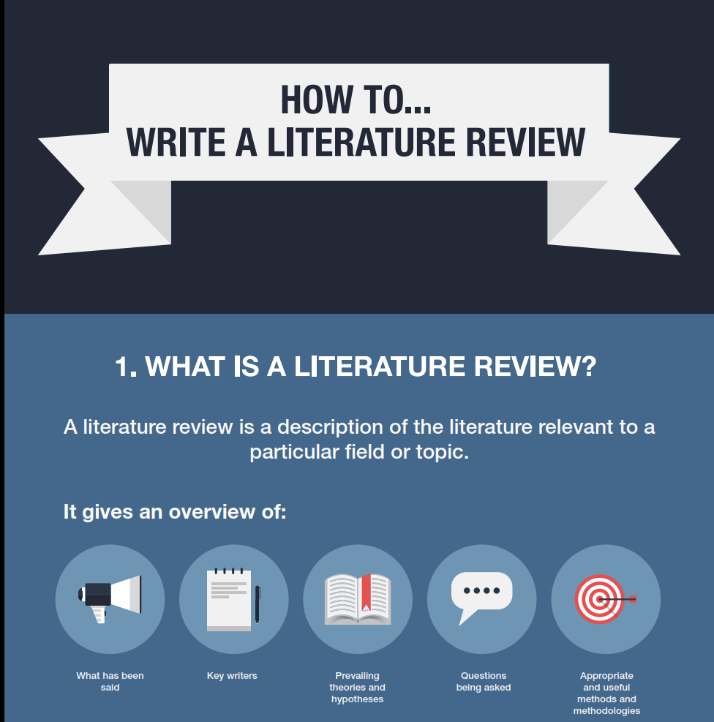
It provides:
What has been already said
Historical background

Slide 18
It provides:
Who are the key writers?
What are main schools of thoughts on an issue?
Comparison of school of thoughts

Slide 19
It provides:
What are the prevailing theories and hypotheses?
Foundations, theoretical frameworks.

Slide 20
It provides:
What questions are being asked?
To note the areas of disagreement
Highlight gaps in the existing research

Slide 21
It provides:
What methods and methodologies are being used by the researchers in the field?
Highlight and critique research methods
To justify the opted research methodology.

Slide 22

It provides:
Foundation of any research/study
Justification for the chosen topic of investigation.
Critical part of your thesis.

Slide 23
By the end of the lit review, the reader should be aware of the current state of the literature and what you will be doing to extend the state of that knowledge.

Slide 24
Objectives (hidden)
You must demonstrate,
an understanding of both the previous research and general writings that are relevant to your research area.
to the examiners your ability to critically integrate and evaluate this literature, rather than provide a simple summary of previous research.

Slide 25
Forms of Lit Rev
Thematic
Purely Descriptive
A descriptive review should not just list and paraphrase, but should add comment and bring out themes and trends.
A critical assessment of the literature in a particular field, starting where the weaknesses and gaps are, contrasting the views of particular authors, or raising questions. It will evaluate and show relationships, so that key themes emerge.
Chronological
By publications: no continuity about the subjects
By trends: Pre-independence, post-independence
Methodological
Focuses on the methods of the researchers

Slide 26
Stages
Define the problem
Literature search
Evaluate the material
Analyse the findings
Write

Slide 27
Stages
Important
Sets the purpose
Narrow the scope
Define the problem

Slide 28
Stages
Literature search
Literature search
Involves searching relevant materials
Books
Peer reviewed journal articles
Newspaper articles
Historical records
Commercial/government reports and statistical information
Theses and dissertations
Other relevant information

Slide 29
Stages
Evaluate the material
Evaluate the materials
What is the central thesis (argument) of the article?
What is the theoretical framework? Eg. Communist, socialist
What are the findings?
How the analysis is done?
How does it contributes to the body of knowledge?
What are the implications of the research
What is the research design? Primary or secondary
Be selective, not all papers need equal important

Slide 30
Stages
Analyse the findings
What themes emerge and what conclusions can be drawn?
What are the major similarities and differences between the various writers?
Which questions could form basis for further investigation?
Are there any significant questions which emerge?
Analyse the findings

Slide 31
Stages
Write
Prepare an outline
Headings and subheadings
Prepare a little summary
Decide a flow of discussion

Slide 32
Organise
organise your material like a Funnel.
more general information is discussed first,
information most closely related to the research is discussed last.
Less specificity of coverage
More specificity of coverage

Slide 33
Organise
Similarly, articles of historical interest or
articles utilising different types of participants or methods than those utilised in your study are presented first.
Group studies according to commonalities such as: approach, attitude, findings.
Each article should not receive the same degree of coverage.
Divide your material into three parts:
material that will be described in detail, because it is highly related to your study
material that will be briefly discussed, and
material that is tangential to your study, which may or may not be included in your lit review

Slide 34
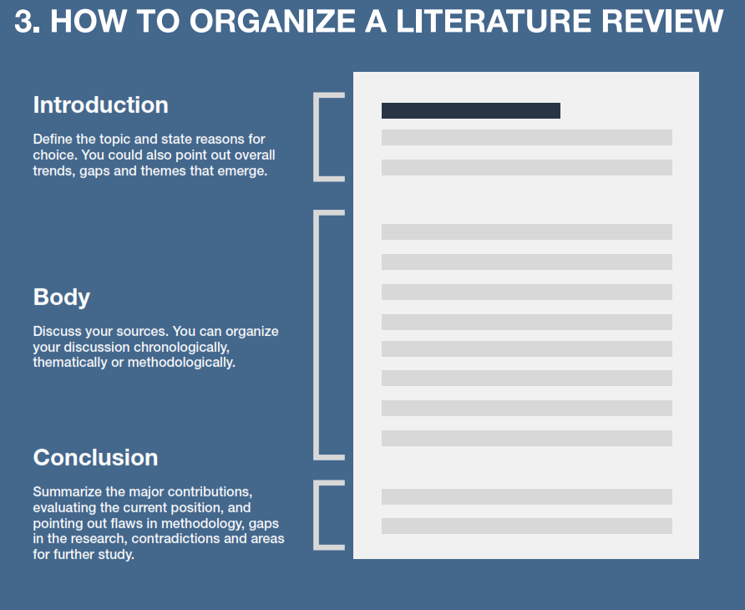

Slide 35
Writing
Use transitions
Transitions provide help connect paragraph together.
Indeed, …
on one hand, …
on the other hand, …
In either case, …
more specifically, …
One of the first researchers to investigate this problem is …
a recent study adds …

Slide 36
Tips
Keep tracks of you sources
be organised
Note cards
Sticky notes
Software annotations
Reference managers,
Mendeley or Zotero(free)
Endnote
Jabref(free) works with BibTex and LaTex

Slide 37
Tips
Clarify with your supervisors
Read some lit reviews in your field of study.
Give yourself time for multiple drafts
Ask somebody else from your field to read your lit review.
Always cite each and every resource you have used.

Slide 38
Take away
literature review is an iterative process rather than a linear process.
Do not write and forget lit review chapter, sometimes substantive restructure is required due to unexpected findings.

Slide 39
Most of the professional and scholarly literature on downtown development has neglected small cities. Frieden and Sagalyn's (1999) widely cited book Downtown, Inc. concentrates on large- scale projects in Seattle, Boston, St. Paul, and San Diego, while Loukaitou-Sideris and Banerjee (1998) profile Los Angeles, San Francisco, and San Diego in their book on downtown design. Almost all the examples provided in Whyte (1988), Abbott (1993), and Robertson (1995) are from large cities, and Brooks and Young (1993) use New Orleans as their case study. The Downtown Development Handbook (McBee, 1992), considered by many to be the bible of downtown development, is heavily dependent on projects in large cities to illustrate key points. Articles addressing a particular downtown development strategy such as retailing (Robertson, 1997; Sawicki, 1989), stadiums (Noll & Zimbalist, 1997; Rosentraub, Swindell, Pryzbylski, & Mullins, 1994), pedestrianization (Byers, 1998; Robertson, 1993), and open space (Loukaitou-Sideris, 1993; Mozingo, 1989) all emphasize large cities as well. The professional magazine Urban Land has published numerous articles on downtown development in recent years, most of which feature a single large city (e.g., Holt, 1998; Howland, 1998; Lockwood, 1996)

Slide 40
The positioning approach to strategy has provided the dominant framework for strategy from the 1950s, with contributions made by Andrews (1987), Ansoff (1987) and Learned et al. (1965). Although the basic framework for this positioning approach appears to have been formulated in the early 1950s, it has been elaborated on and developed by a number of writers. Arguably, amongst these the most important contributor has been Porter (1980, 1985, 1987, 1993), with his development of the concept of the five forces model used for industry analysis, the value chain as an instrument for assessing internal organizational strengths and weaknesses, and the generic strategies as a tool to assist in strategy evaluation. Theorists such as Ansoff (1968), Porter (1980) and Selznick (1957) have discussed the importance of internal analysis and developed the competence grid and the value chain as aids to this analysis. But the major focus has tended to be on the external environment, with the common assumption underlying the approach that the environment largely determines the organization’s freedom to manoeuvre. Therefore the structure of the environment is seen to be of overwhelming importance, and a strategy for delivering competitive advantage will be one that positions the organization within that environment. The problem for the strategist then becomes one of finding a position that is defensible against the threats from existing and potential competitors and also from the bargaining power of suppliers and buyers . . .

Slide 41
Step3: Specifying purpose of research
or Formulating the objectives
Objectives are the goals you set out to attain in your study.
They inform a reader what you want to attain through the study.
It is extremely important to word them clearly and specifically.
The main objective is an overall statement of the thrust of your study.
It is also a statement of the main associations and relationships that you seek to discover or establish.
The sub-objectives are the specific aspects of the topic that you want to investigate within the main framework of your study.
They should be numerically listed.
Wording should clearly, completely and specifically Communicate to your readers your intention.
Each objective should contain only one aspect of the Study.
Use action oriented words or verbs when writing objectives.
The objectives should start with words such as ‘to determine’, ‘to find out’, ‘to ascertain’, ‘to measure’, ‘to explore’ etc.
Clear +Complete +Specific + Identify main variables to be correlated + Identify the direction of relationship

Slide 42
Step4: Development of working hypotheses
Working hypothesis is tentative assumption made in order to draw out and test its logical or empirical consequences.
Hypothesis should be very specific and limited to the piece of research in hand because it has to be tested.
The formulation of hypothesis provides a study with focus. It tells you what specific aspects of a research problem to investigate.
A hypothesis tells you what data to collect and what not to collect, thereby providing focus to the study.
As it provides a focus, the construction of a hypothesis enhances objectivity in a study.
A hypothesis may enable you to add to the formulation of a theory. It enables you to specifically conclude what is true or what is false.

Slide 43
How to develop working hypotheses
Discussions with colleagues and experts about the problem, its origin and the objectives in seeking a solution;
Examination of data and records, if available, concerning the problem for possible trends, peculiarities and other clues;
Review of similar studies in the area or of the studies on similar problems; and
Exploratory personal investigation which involves original field interviews on a limited scale with interested parties and individuals with a view to secure greater insight into the practical aspects of the problem.

